Slide 1
Group 14 Intergalatic Bookstore
Alex Polley, Ryan Manthorp, Daniel Pokladek, Tom Mclaren

Slide 2
Logline/ Introduction (Ryan)
The history of earth is at risk when book mites that consume history invade a bookshop on the moon
Book mites eat books which subsequently destroy pieces of history, to stop this player must shoot mites before they eat books. The player must also organise books in chronological order.
Emotions: Monachopsis, Vellichor

Slide 3
Target Audience (Tom)
Male children and teenagers
Ages 8- 16
Like puzzle games
Educational for children
Teenagers & young adults will find the historical theme interesting.
Young Adults and Teenagers will be interested in the historical and educational theme of sorting books chronologically.
In relation to the obscure sorrows, Vellichor will take our target audience back to when they were young and taking books out from book stores
Notes:
Teenagers and Kids:
historical theme of sorting books and learning history ++
Educational theme can be appealing to students and kids
Young Adults & Teenagers:
Majority of mobile players ++
They will find the theme of history interesting
Puzzle games go well with mobile games, as they are easy to play on mobile platforms

Slide 4
Video Walkthrough (Daniel, Tom)
Talk about changes made to the games mechanics (Daniel)
Talk about how we made changes to the bookshelves and level in general so that the player could clearly see what to click on (Tom)

Slide 5
Lessons learnt and changes made (Alex)
Dont treat the player as if they are stupid
Don’t waste the players time
Perform squint tests and go through visual hierarchy

Slide 6
Management (Alex, Ryan)
No hours logged until meeting with Rob
Hours logged in GitHub comments
Alex- 34
Ryan- 5
Tom- 19.5 (commented in commits)
Daniel- 3
Emails sent:
Alex- 27
Ryan- 23
Daniel- 23
Tom- 28

Slide 7
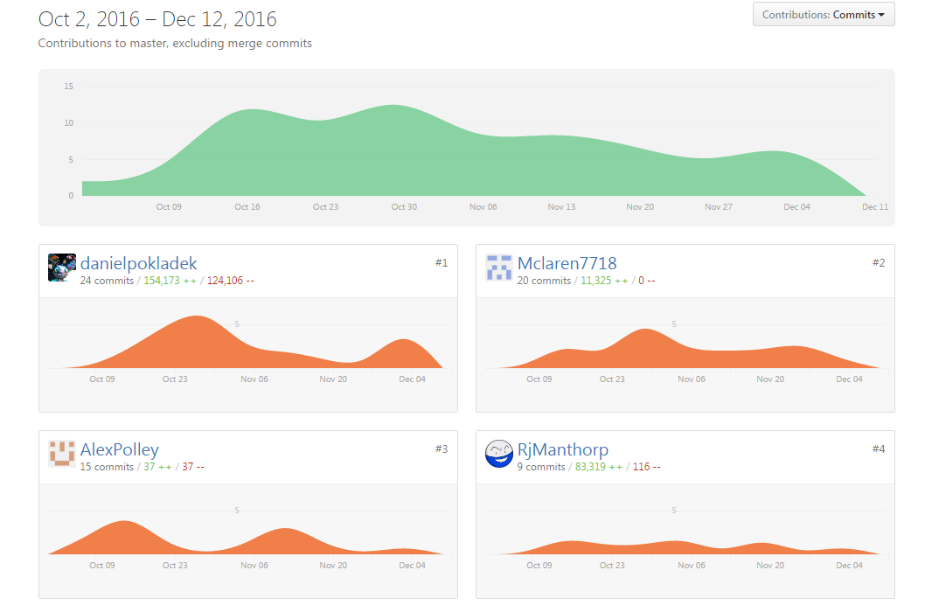
Commits

Slide 8
Questions

